Slide 1
Online Learning Platform using MERN Stack
TEAM MEMBERS:
D.Tharunika - 211520205168
S.Swetha - 211521205165
V.Theja shree - 211521205169
E.V.Swetha - 211521205163

Slide 2
Abstract
The aim of this project is to develop an online E-learning platform using the MERN stack (MongoDB, Express.js, React, and Node.js). The platform offers users an interactive environment where they can access learning materials, take quizzes, and track their progress. The system is scalable, fast, and efficient, providing both teachers and students with seamless user experiences. Key features include user authentication, course management, and real-time communication.

Slide 3
Introduction
With the rapid growth of technology, online education has become a vital part of the learning experience. E-learning platforms offer flexibility and convenience, making education accessible to a wide range of students. In this project, we developed an online learning platform using the MERN stack. The system is designed to provide course management, real-time interaction, and learning resources in a user-friendly environment. This report outlines the architecture, development process, and future implementations.

Slide 4
The MERN stack is a popular technology stack for building web applications.
It consists of:
MongoDB: A NoSQL database for storing and retrieving data.
Express.js: A Node.js web framework for building APIs.
React.js: A JavaScript library for building user interfaces.
Node.js: A JavaScript runtime environment for executing server-side code.

Slide 5
Proposed System / Future Implementation
The proposed system is an interactive e-learning platform that enables instructors to create and manage courses, while students can enroll in these courses, access materials, and track their progress. Future implementations may include advanced features like AI-driven personalised learning paths, integration with external educational platforms, and support for mobile applications.
Key Future Features:
AI-Powered Recommendations: Suggest courses based on learning behaviour.
Mobile App Development: Extend the platform to iOS and Android for seamless mobile access.
Gamification: Introduce reward systems, badges, and leaderboards to encourage participation.

Slide 6
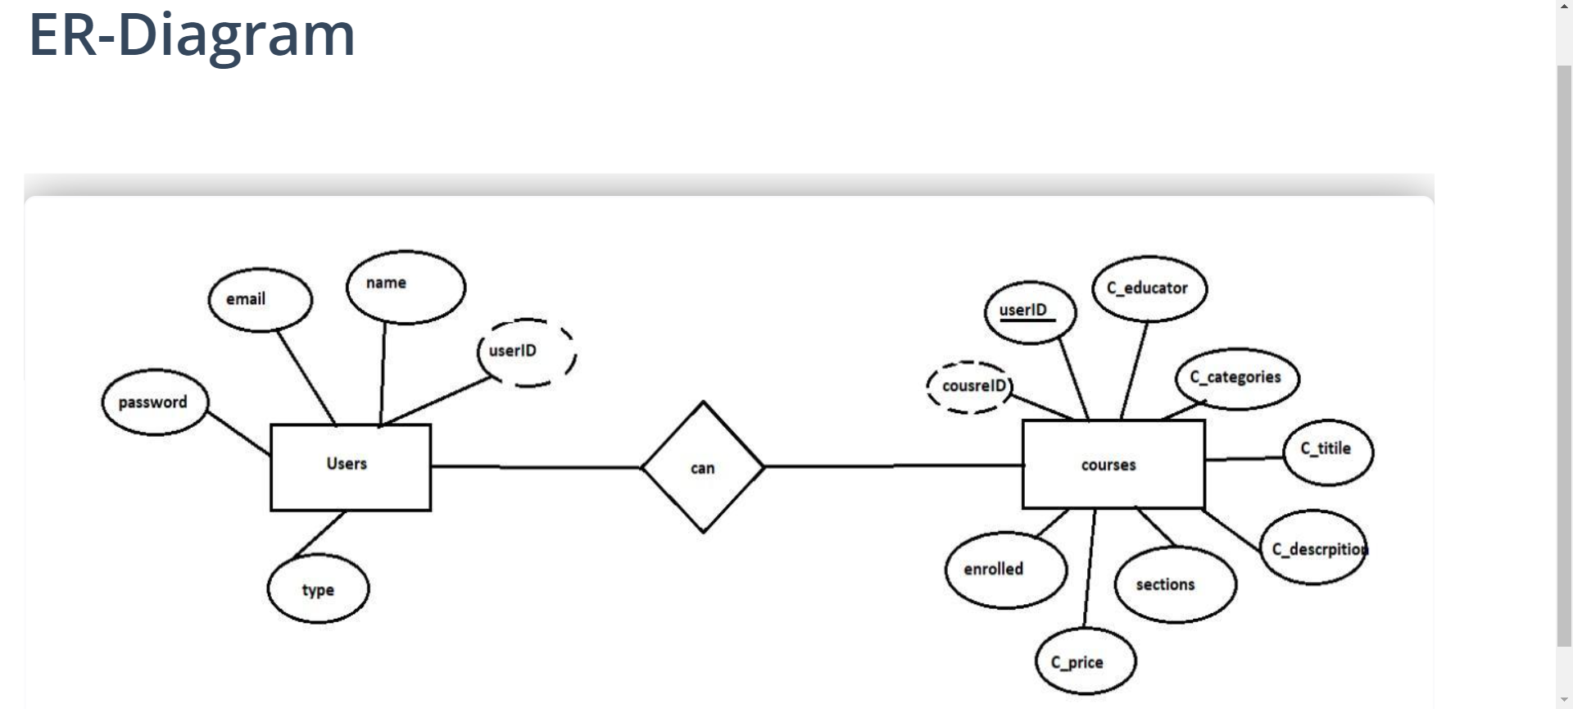
Architecture Diagram

Slide 7
Front-End Development
The front end of the e-learning platform is built using React.js. The main focus is to create a responsive, user-friendly interface that provides a seamless experience for both students and instructors.
React.js: Component-based architecture was used to build reusable UI components like course cards, dashboards, and user profiles.
Responsive Design: Ensured that the platform is mobile-friendly using CSS frameworks like Bootstrap.
State Management: Implemented Redux to manage the state of the application, particularly for user sessions, course progress, and quizzes.

Slide 8
Back-End Development
The backend is developed using Node.js and Express.js, which handles the server-side logic, including user authentication, course management, and database interactions.
Node.js & Express.js: Designed a RESTful API to handle all operations like user login, course creation, and real-time data exchange.
Authentication: Used JWT (JSON Web Tokens) for secure login and session management.
MongoDB: As the NoSQL database, MongoDB stores all user data, course content, and other dynamic resources.

Slide 9
Integration
Integration was achieved through seamless communication between the front-end and back-end systems using API requests. The Axios library was used to make HTTP requests from React.js to the Express.js server. The database was connected using Mongoose, a MongoDB object modeling tool, to handle data queries and manipulation.

Slide 10



Slide 11
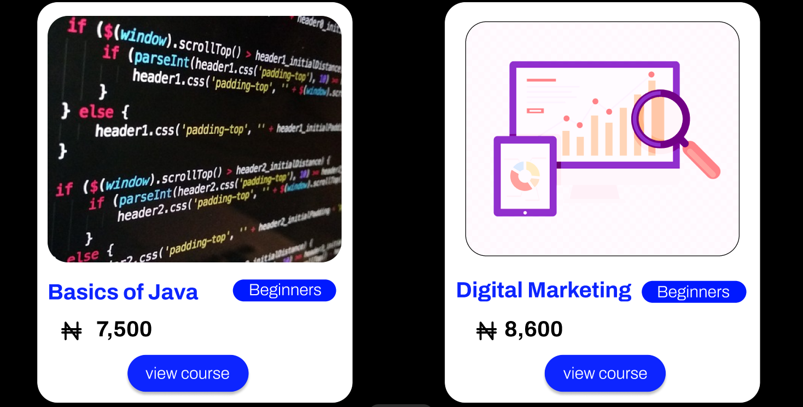
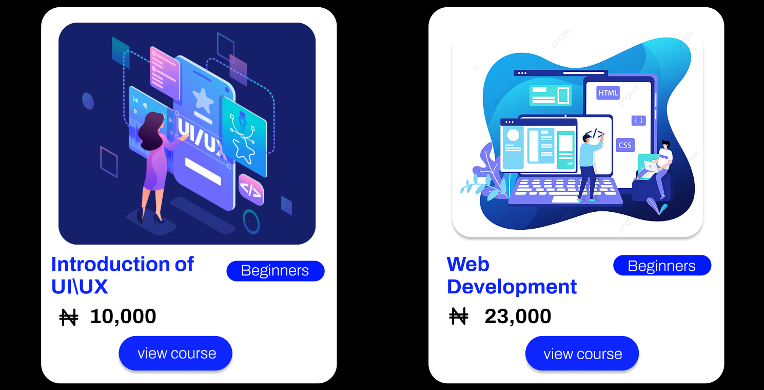

Slide 12
Conclusion
This e-learning platform developed using the MERN stack provides a robust solution for modern online education. It is scalable, flexible, and user-centric, offering a full suite of features for both instructors and students. Future enhancements will focus on personalization, mobile accessibility, and advanced analytics to further improve the learning experience.

Slide 13
Thank You

